Slide 1

Project:
Renovation Works at Ricci Hall at 93 Pok Fu Lam Road
VIEW 3
VIEW 1
VIEW 4
VIEW 5
VIEW 2
C
Sub-basement Level
VIEW 6
PROGRESS PHOTO REPORT - 04
Date : 2014-8-26

Slide 2
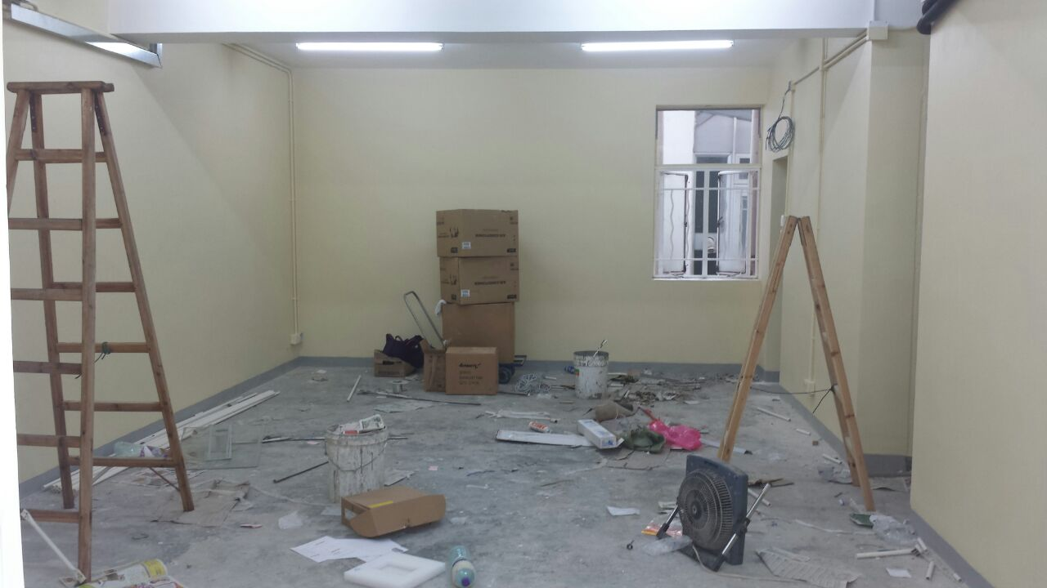
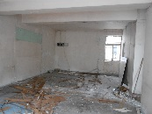
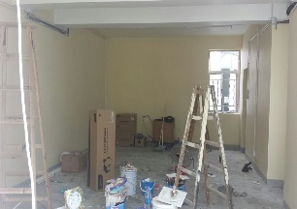
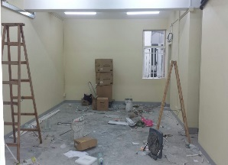
Descriptions
Paint to wall was completed
VIEW 1
2014-7-6
2014-8-14
2014-8-21

Slide 3
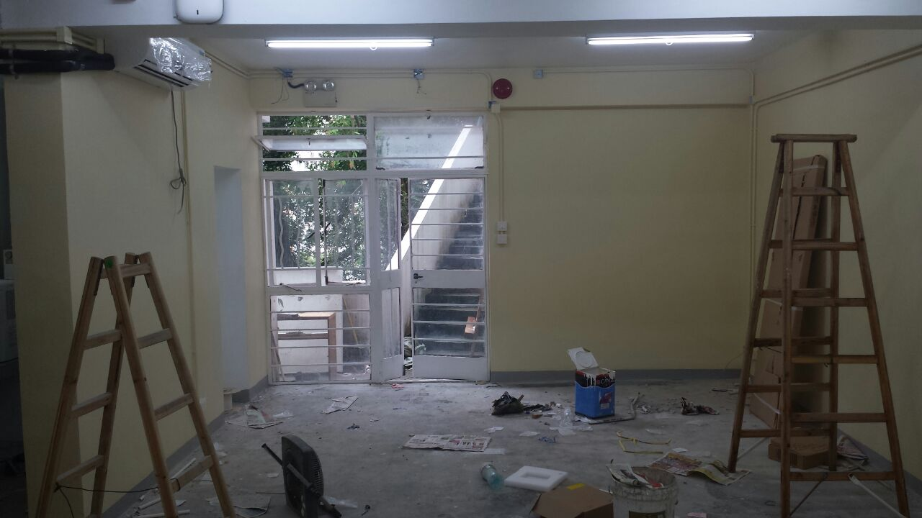
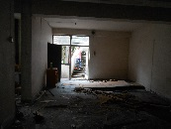
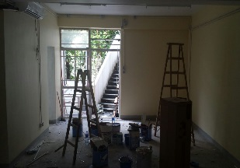
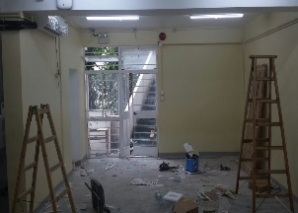
Descriptions
Paint to wall was completed
A/C equipment has installed on site
VIEW 2
2014-7-6
2014-8-14
2014-8-21

Slide 4
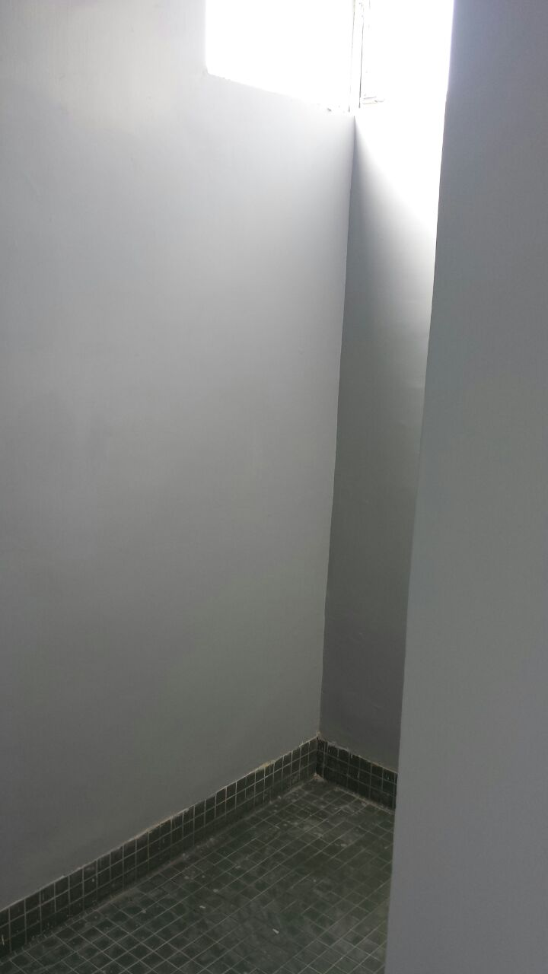
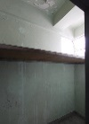
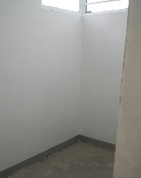
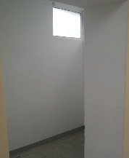
Descriptions
Paint to wall was completed
VIEW 3
2014-7-6
2014-8-14
2014-8-21

Slide 5
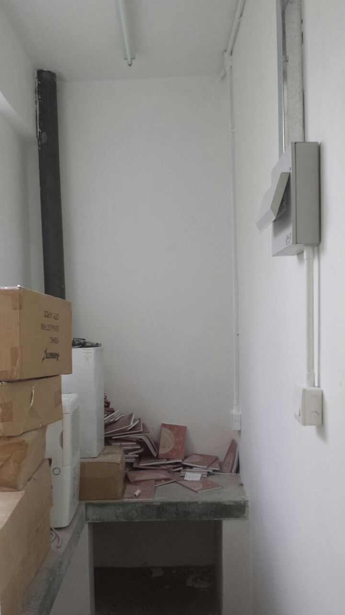
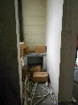
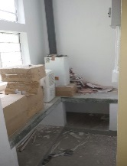

Descriptions
Paint to wall was completed
VIEW 4
2014-7-6
2014-8-14
2014-8-21

Slide 6
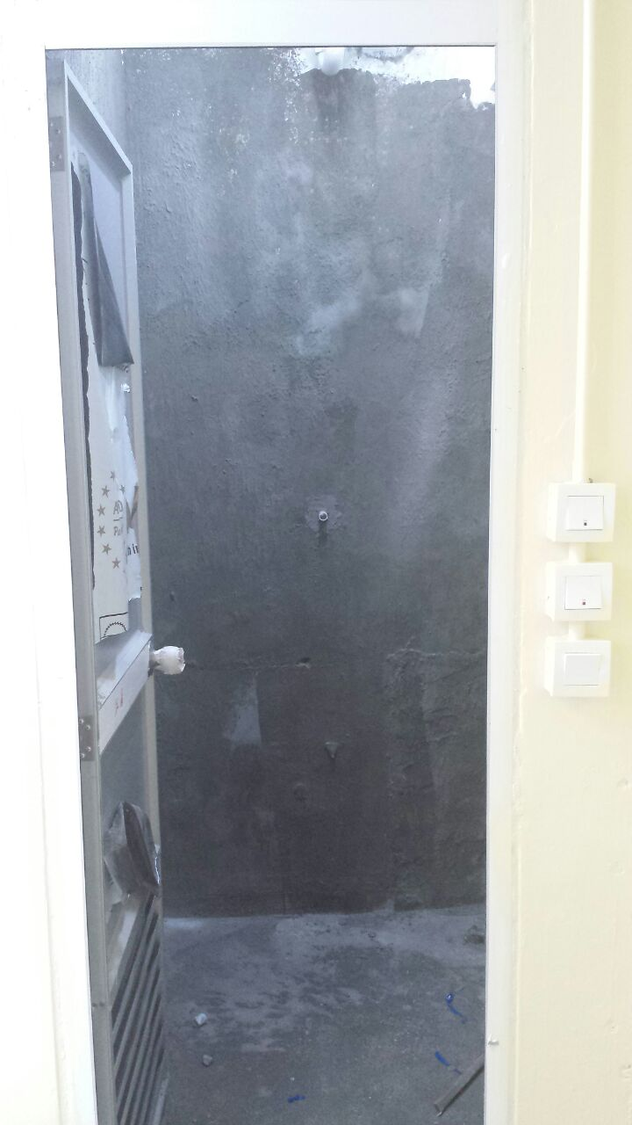
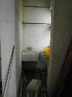
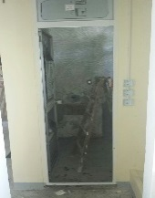

Descriptions
Site condition
VIEW 5
2014-7-6
2014-8-14
2014-8-21

Slide 7
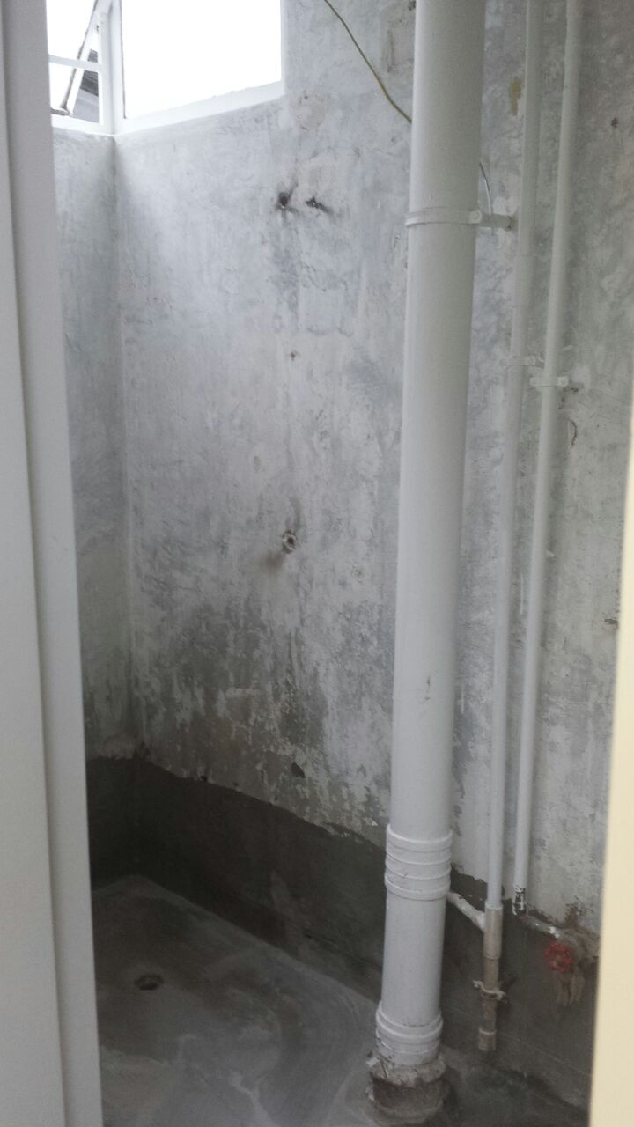
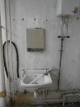
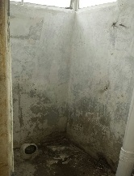

Descriptions
Site condition
VIEW 6
2014-7-6
2014-8-14
2014-8-21

Slide 8
Project:
Renovation Works at Ricci Hall at 93 Pok Fu Lam Road
VIEW 4
VIEW 2
VIEW 5
VIEW 6
VIEW 1
VIEW 7
C
Ground Floor
VIEW 8
VIEW 3
PROGRESS PHOTO REPORT - 04
Date : 2014-8-26

Slide 9
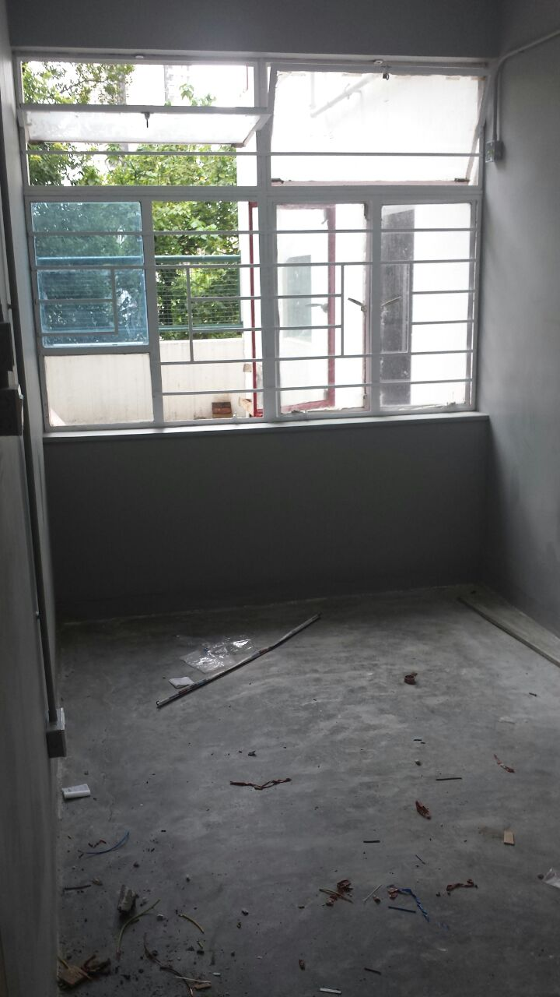
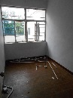
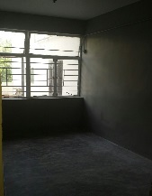
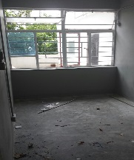
Descriptions
Paint to wall was completed
VIEW 1
2014-7-6
2014-8-14
2014-8-21

Slide 10
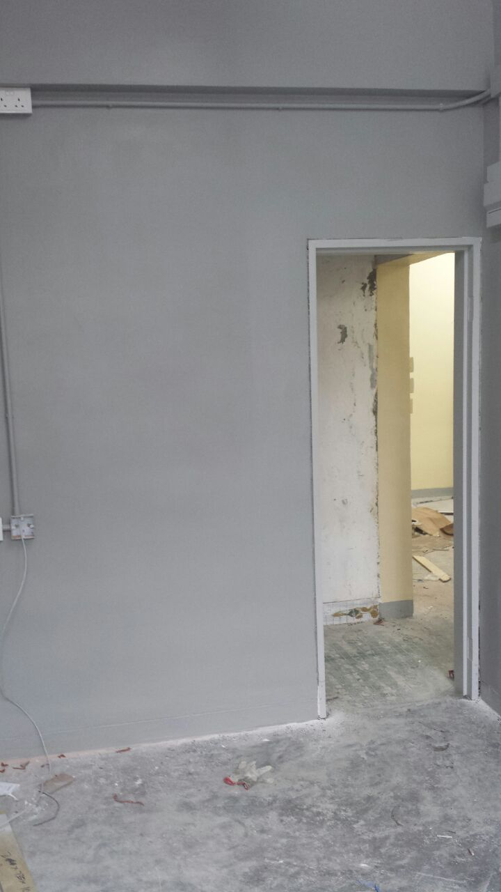
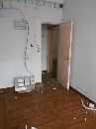
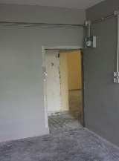
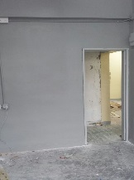
Descriptions
Paint to wall was completed
The door frame has installed
VIEW 2
2014-7-6
2014-8-14
2014-8-21

Slide 11
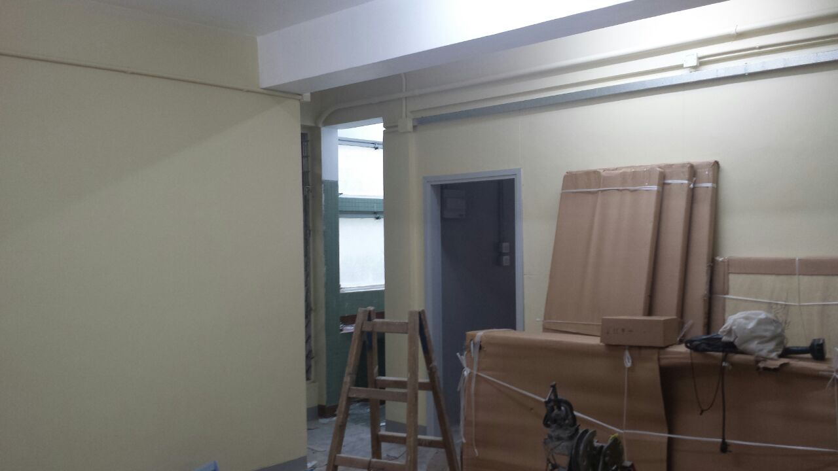
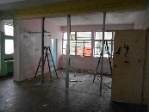
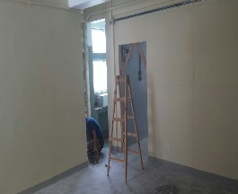

Descriptions
Paint to wall was completed
Furniture arrived on site
VIEW 3
2014-7-6
2014-8-14
2014-8-21

Slide 12
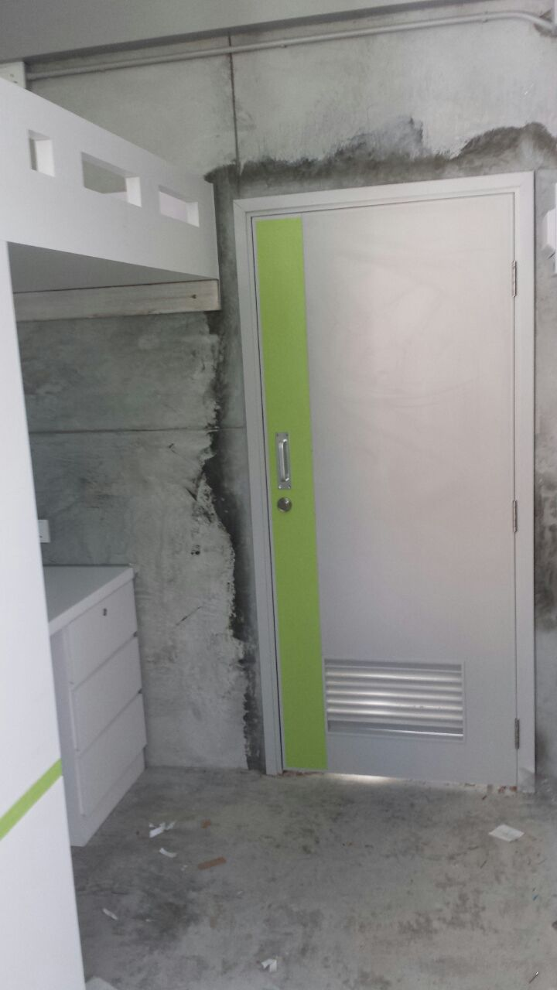
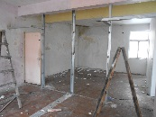
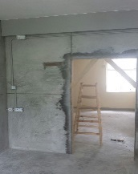
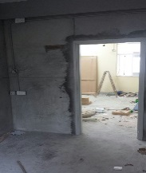
Descriptions
Plastering works in progress
The door has installed
Furniture has installed
VIEW 4
2014-7-6
2014-8-14
2014-8-21

Slide 13
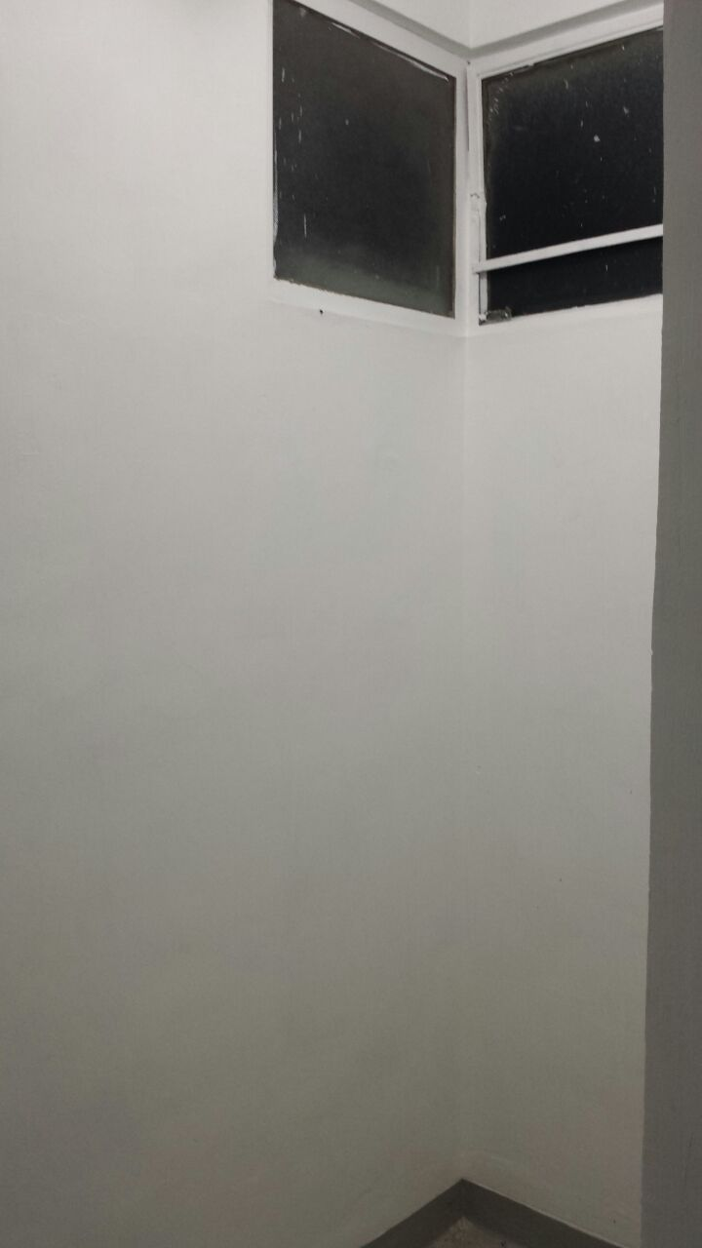
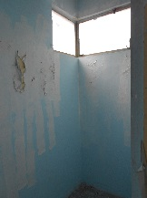
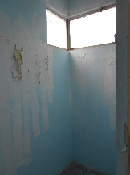
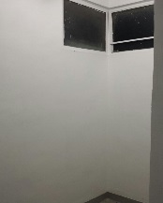
Descriptions
Paint to wall was completed
VIEW 5
2014-7-6
2014-8-14
2014-8-21

Slide 14
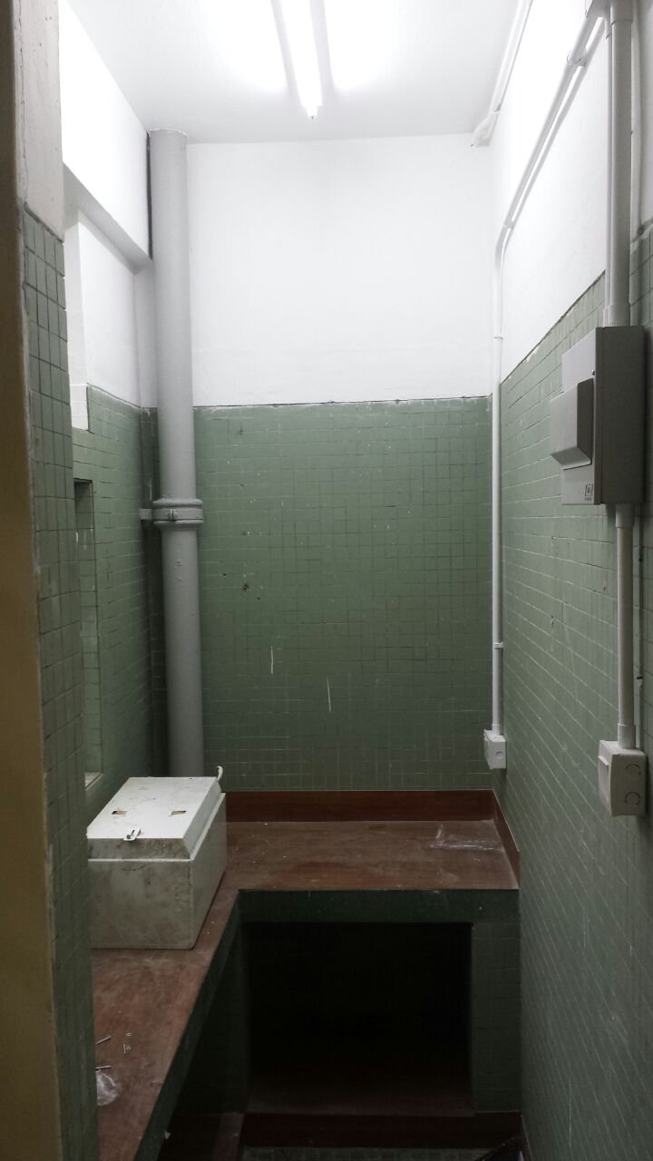
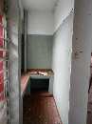
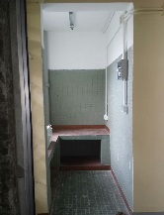

Descriptions
Paint to wall was completed
VIEW 6
2014-7-6
2014-8-14
2014-8-21

Slide 15
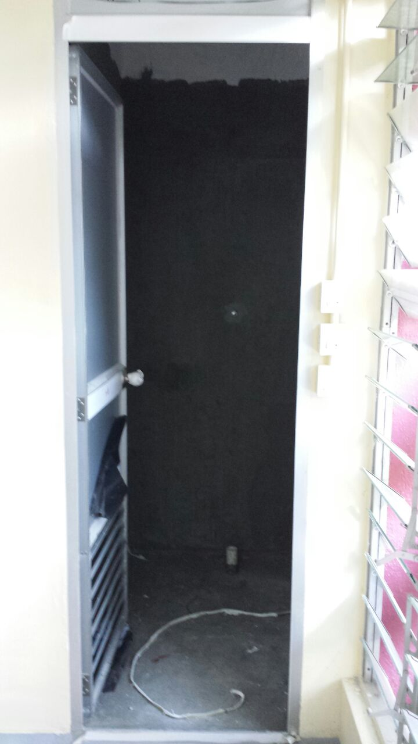
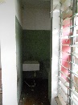
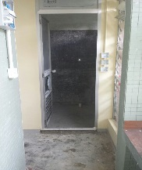
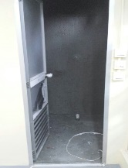
Descriptions
Site condition
VIEW 7
2014-7-6
2014-8-14
2014-8-21

Slide 16
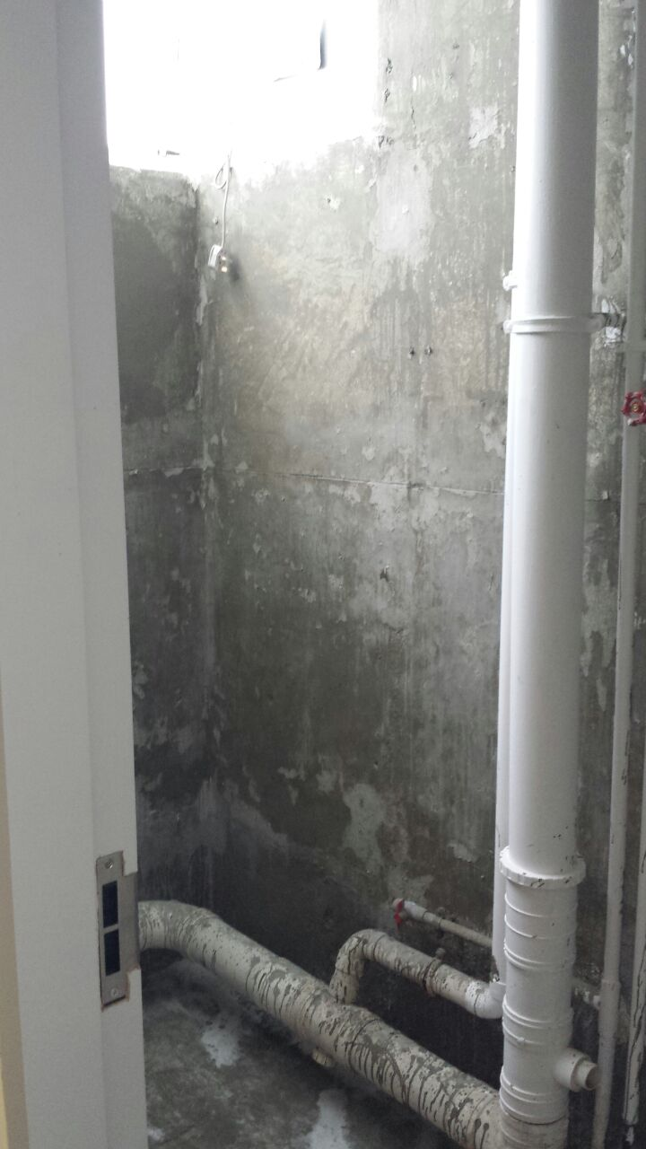
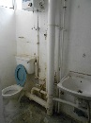
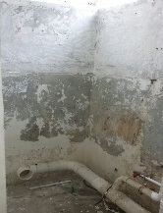

Descriptions
All the existing finish will be demolish
VIEW 8
2014-7-6
2014-8-14
2014-8-21

Slide 17

Project:
Renovation Works at Ricci Hall at 93 Pok Fu Lam Road
A
Ground Floor
VIEW 7
VIEW 5
VIEW 3
VIEW 9
B
Ground Floor
VIEW 10
VIEW 4
VIEW 8
VIEW 6
VIEW 7
VIEW 5
VIEW 3
VIEW 1
VIEW 1
VIEW 2
VIEW 2
VIEW 8
VIEW 6
VIEW 4
VIEW 14
VIEW 7
VIEW 6
VIEW 3
VIEW 1
VIEW 9
C
First Floor
VIEW 10
VIEW 13
VIEW 8
VIEW 2
VIEW 11
VIEW 12
VIEW 5
VIEW 4
PROGRESS PHOTO REPORT - 04
Date : 2014-8-26

Slide 18





Descriptions
Paint to wall was completed
A
Ground Floor
VIEW 1
2014-7-6
2014-8-14
2014-8-21

Slide 19





Descriptions
Paint to wall was completed
A
Ground Floor
VIEW 2
2014-7-6
2014-8-14
2014-8-21

Slide 20




Descriptions
Plastering works was completed
Furniture has installed
A
Ground Floor
VIEW 3
2014-7-6
2014-8-14
2014-8-21

Slide 21



Descriptions
Paint to wall was completed
Furniture has installed
A
Ground Floor
VIEW 4
2014-7-6
2014-8-14
2014-8-21

Slide 22



Descriptions
Plastering works was completed
Furniture has installed
A
Ground Floor
VIEW 5
2014-7-6
2014-8-14
2014-8-21

Slide 23



Descriptions
Site condition
A
Ground Floor
VIEW 6
2014-7-6
2014-8-14
2014-8-21

Slide 24



Descriptions
Plastering works was completed
Furniture has installed
A
Ground Floor
VIEW 7
2014-7-6
2014-8-14
2014-8-21

Slide 25



Descriptions
Plastering works was completed
Furniture has installed
A
Ground Floor
VIEW 8
2014-7-6
2014-8-14
2014-8-21

Slide 26



Descriptions
Plastering works was completed
Furniture has installed
A
Ground Floor
VIEW 9
2014-7-6
2014-8-14
2014-8-21

Slide 27




Descriptions
Site condition
A
Ground Floor
VIEW 10
2014-7-6
2014-8-14
2014-8-21

Slide 28




Descriptions
Plastering works was completed
Furniture has installed
B
Ground Floor
VIEW 1
2014-7-6
2014-8-14
2014-8-21

Slide 29



Descriptions
Site condition
B
Ground Floor
VIEW 2
2014-7-6
2014-8-14
2014-8-21

Slide 30



Descriptions
Plastering works was completed
Furniture has installed
B
Ground Floor
VIEW 3
2014-7-6
2014-8-14
2014-8-21

Slide 31



Descriptions
Paint to wall was completed
B
Ground Floor
VIEW 4
2014-7-6
2014-8-14
2014-8-21

Slide 32



Descriptions
Plastering works was completed
Furniture has installed
B
Ground Floor
VIEW 5
2014-7-6
2014-8-14
2014-8-21

Slide 33



Descriptions
Site condition
B
Ground Floor
VIEW 6
2014-7-6
2014-8-14
2014-8-21

Slide 34




Descriptions
Plastering works was completed
Furniture has installed
B
Ground Floor
VIEW 7
2014-7-6
2014-8-14
2014-8-21

Slide 35



Descriptions
Furniture has installed
B
Ground Floor
VIEW 8
2014-7-6
2014-8-14
2014-8-21

Slide 36




Descriptions
Paint to wall was completed
The door frame has installed
B
Ground Floor
VIEW 9
2014-7-6
2014-8-14
2014-8-21

Slide 37




Descriptions
Paint to wall was completed
The door frame has installed
B
Ground Floor
VIEW 10
2014-7-6
2014-8-14
2014-8-21

Slide 38




Descriptions
Site condition
B
Ground Floor
VIEW 11
2014-7-6
2014-8-14
2014-8-21

Slide 39




Descriptions
Site condition
B
Ground Floor
VIEW 12
2014-7-6
2014-8-14
2014-8-21

Slide 40




Descriptions
Paint to wall was completed
B
Ground Floor
VIEW 13
2014-7-6
2014-8-14
2014-8-21

Slide 41




Descriptions
Paint to wall was completed
B
Ground Floor
VIEW 14
2014-7-6
2014-8-14
2014-8-21

Slide 42



Descriptions
Plastering works was completed
Furniture has installed
C
Ground Floor
VIEW 1
2014-7-6
2014-8-14
2014-8-21

Slide 43



Descriptions
Furniture has installed
C
Ground Floor
VIEW 2
2014-7-6
2014-8-14
2014-8-21

Slide 44



Descriptions
Plastering works was completed
Furniture has installed
C
Ground Floor
VIEW 3
2014-7-6
2014-8-14
2014-8-21

Slide 45



Descriptions
Furniture has installed
C
Ground Floor
VIEW 4
2014-7-6
2014-8-14
2014-8-21

Slide 46



Descriptions
Furniture has installed
C
Ground Floor
VIEW 5
2014-7-6
2014-8-14
2014-8-21

Slide 47



Descriptions
Plastering works was completed
Furniture has installed
C
Ground Floor
VIEW 6
2014-7-6
2014-8--14
2014-8-21

Slide 48



Descriptions
Paint to wall was completed
C
Ground Floor
VIEW 7
2014-7-6
2014-8-14
2014-8-21

Slide 49



Descriptions
Paint to wall was completed
C
Ground Floor
VIEW 8
2014-7-6
2014-8-14
2014-8-21

Slide 50
Project:
Renovation Works at Ricci Hall at 93 Pok Fu Lam Road
B
First Floor
E
First Floor
E
First Floor
VIEW 2
VIEW 3
VIEW 1
VIEW 1
VIEW 1
VIEW 2
VIEW 2
PROGRESS PHOTO REPORT - 04
Date : 2014-8-26

Slide 51




Descriptions
Tile works was completed
B
First Floor
VIEW 1
2014-7-6
2014-8-14
2014-8-21

Slide 52




Descriptions
Plastering works was completed
B
First Floor
VIEW 2
2014-7-6
2014-8-14
2014-8-21

Slide 53




Descriptions
Tile works was completed
B
First Floor
VIEW 3
2014-7-6
2014-8-14
2014-8-21

Slide 54




Descriptions
Tile works was completed
E
First Floor
Female Toilet & Disable toilet
VIEW 1
2014-7-6
2014-8-14
2014-8-21

Slide 55




Descriptions
Tile works was completed
E
First Floor
Female Toilet & Disable toilet
VIEW 2
2014-7-6
2014-8-14
2014-8-21

Slide 56




Descriptions
Tile works was completed
E
First Floor
Male Toilet
VIEW 1
2014-7-6
2014-8-14
2014-8-21

Slide 57




Descriptions
Tile works was completed
The door frame has installed
E
First Floor
Male Toilet
VIEW 2
2014-7-6
2014-8-14
2014-8-21

